Slide 1
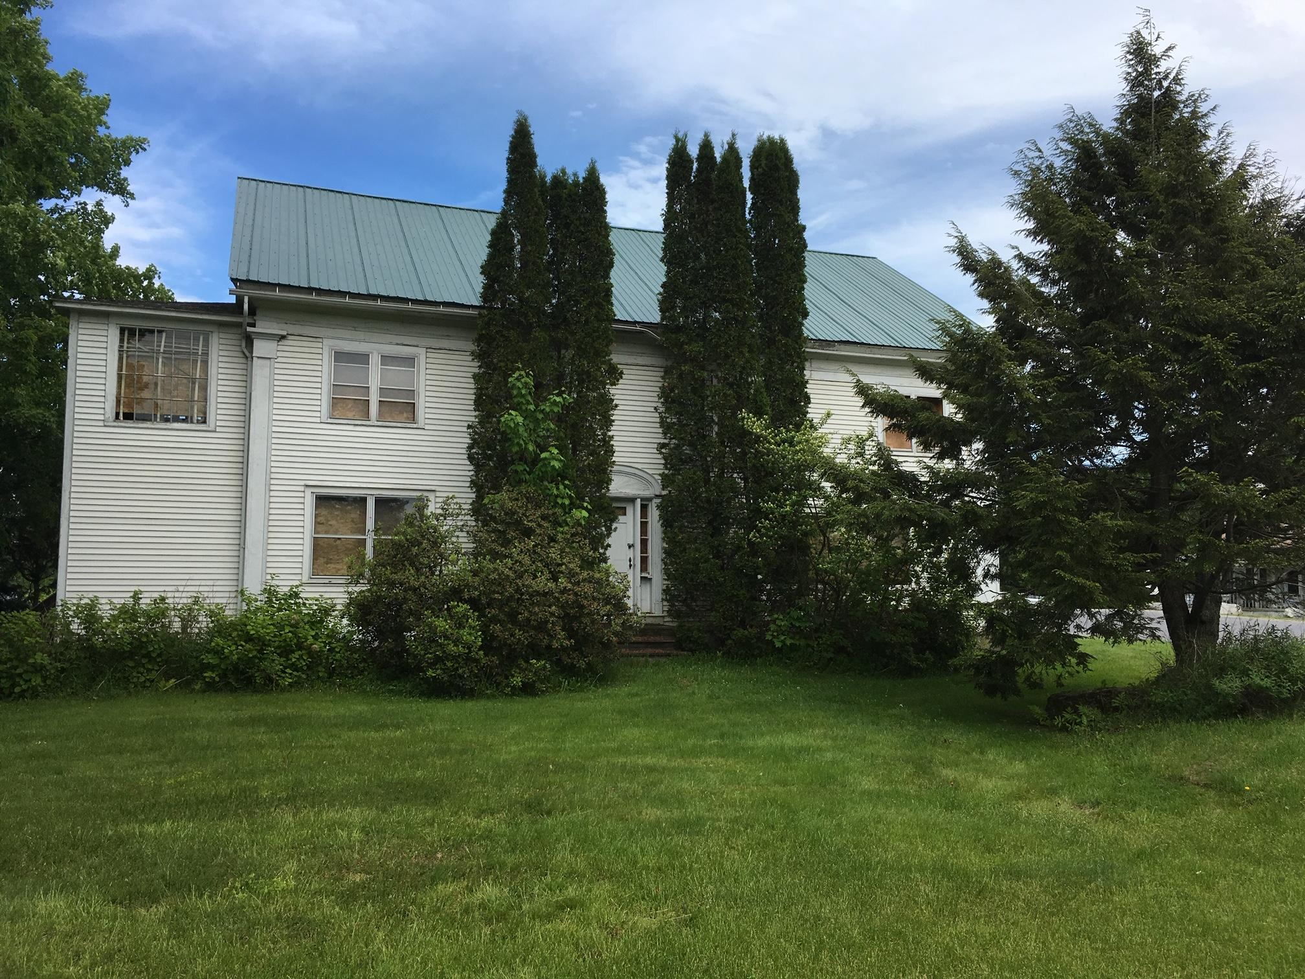
1976 Mountain Road

Slide 2
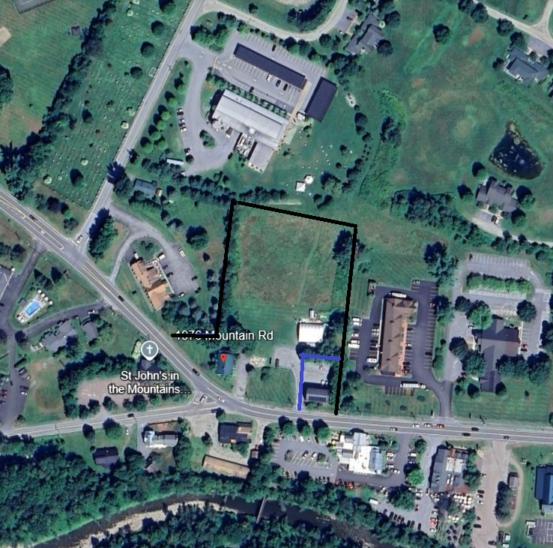
1976 Mountain Road
Entrance to Mountain Road Village
Part of a larger site
Part of the town’s Route 108 Master Plan
Needs to be thoughtfully envisioned and planned for the long term, to create a real sense of PLACE

Slide 4
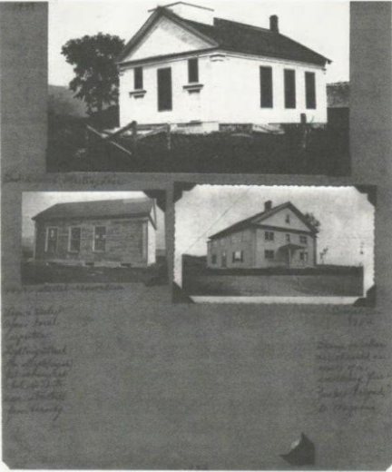
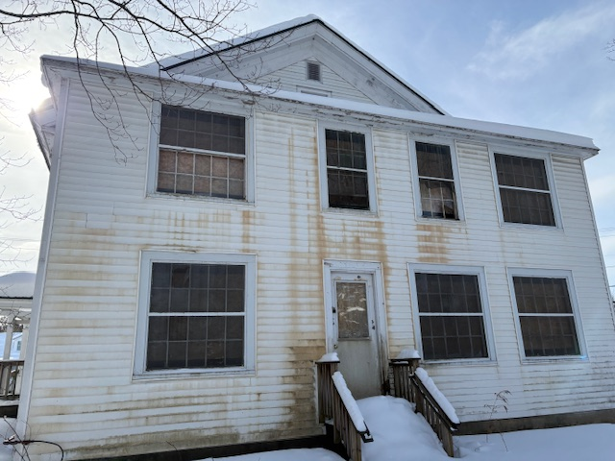
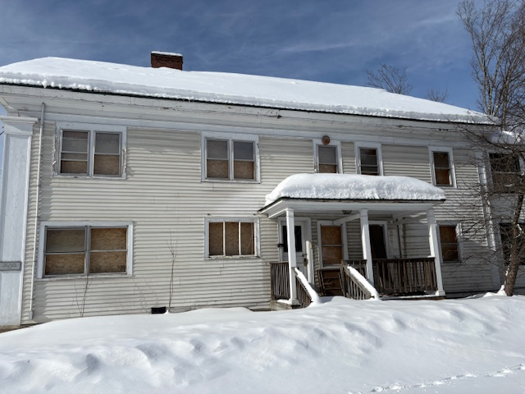
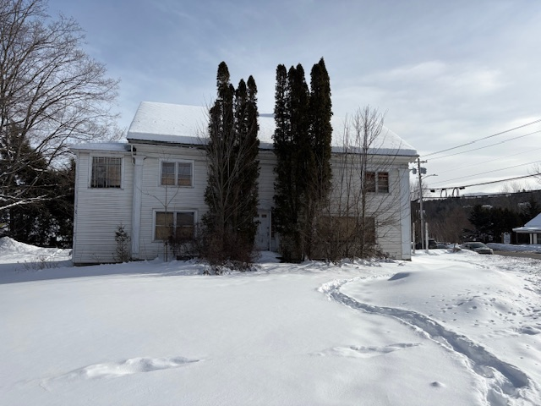
History

Slide 5
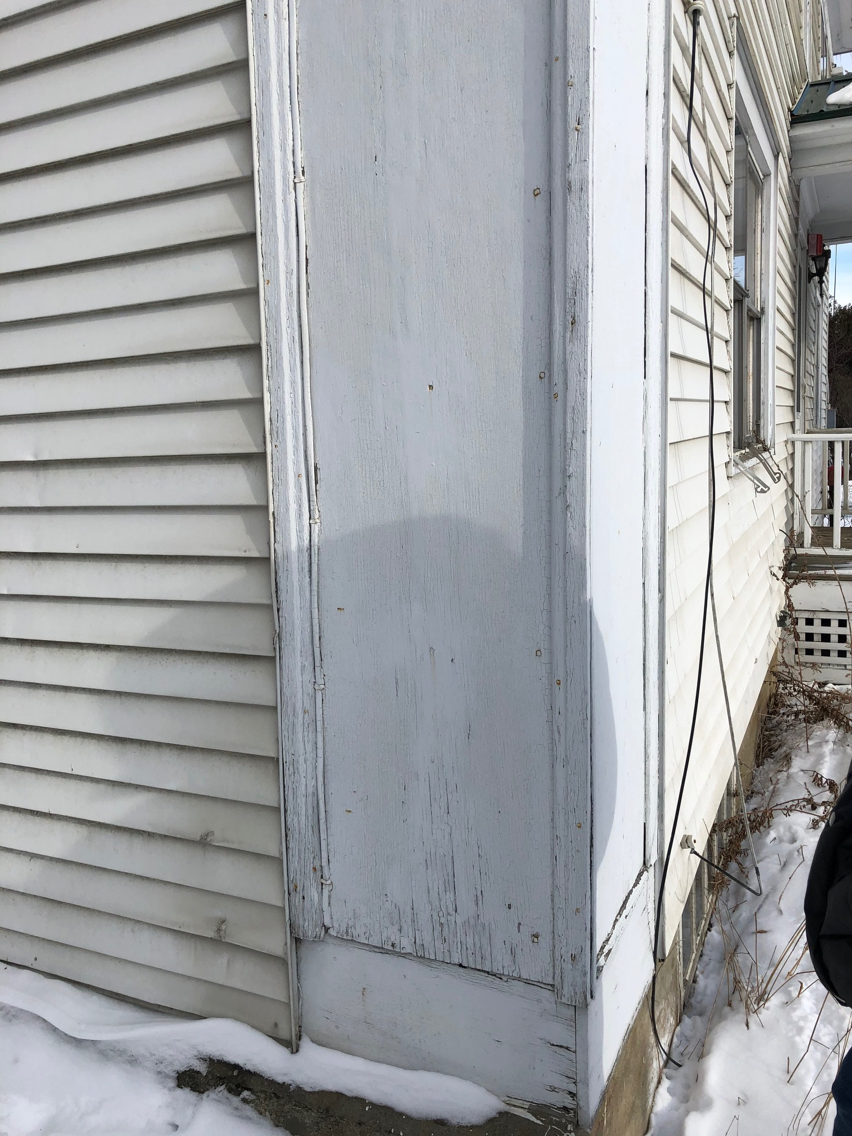
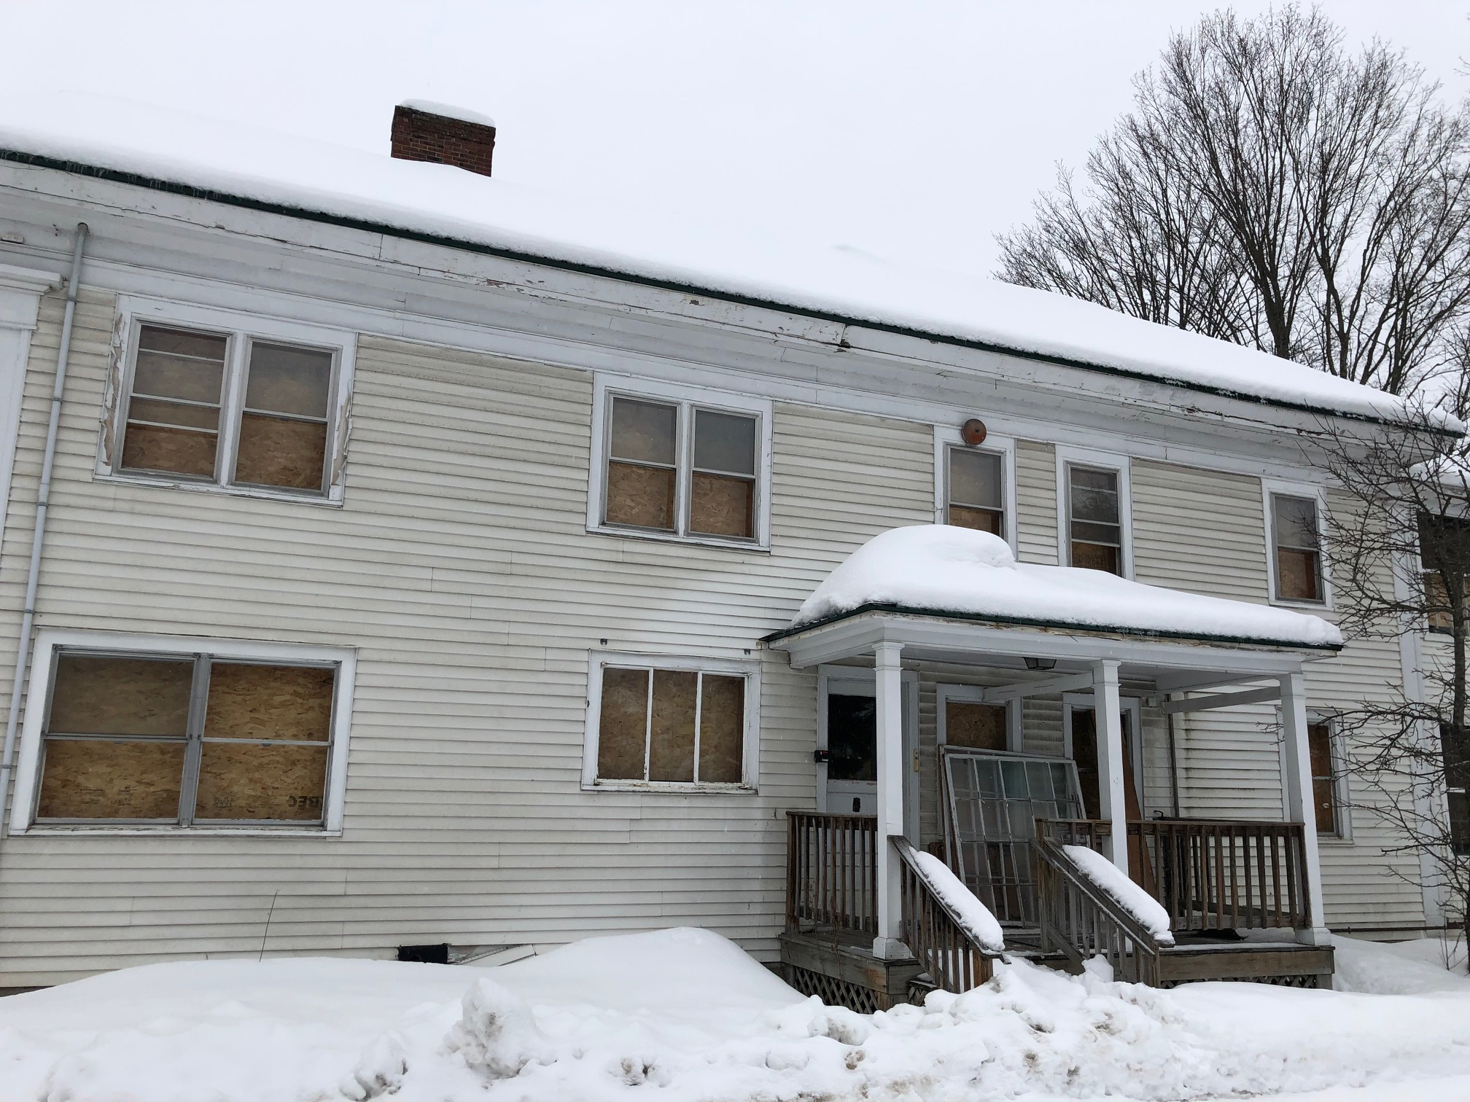
PLYWOOD
METAL, UNDIVIDED LIGHT
*don’t match original locations

Slide 6
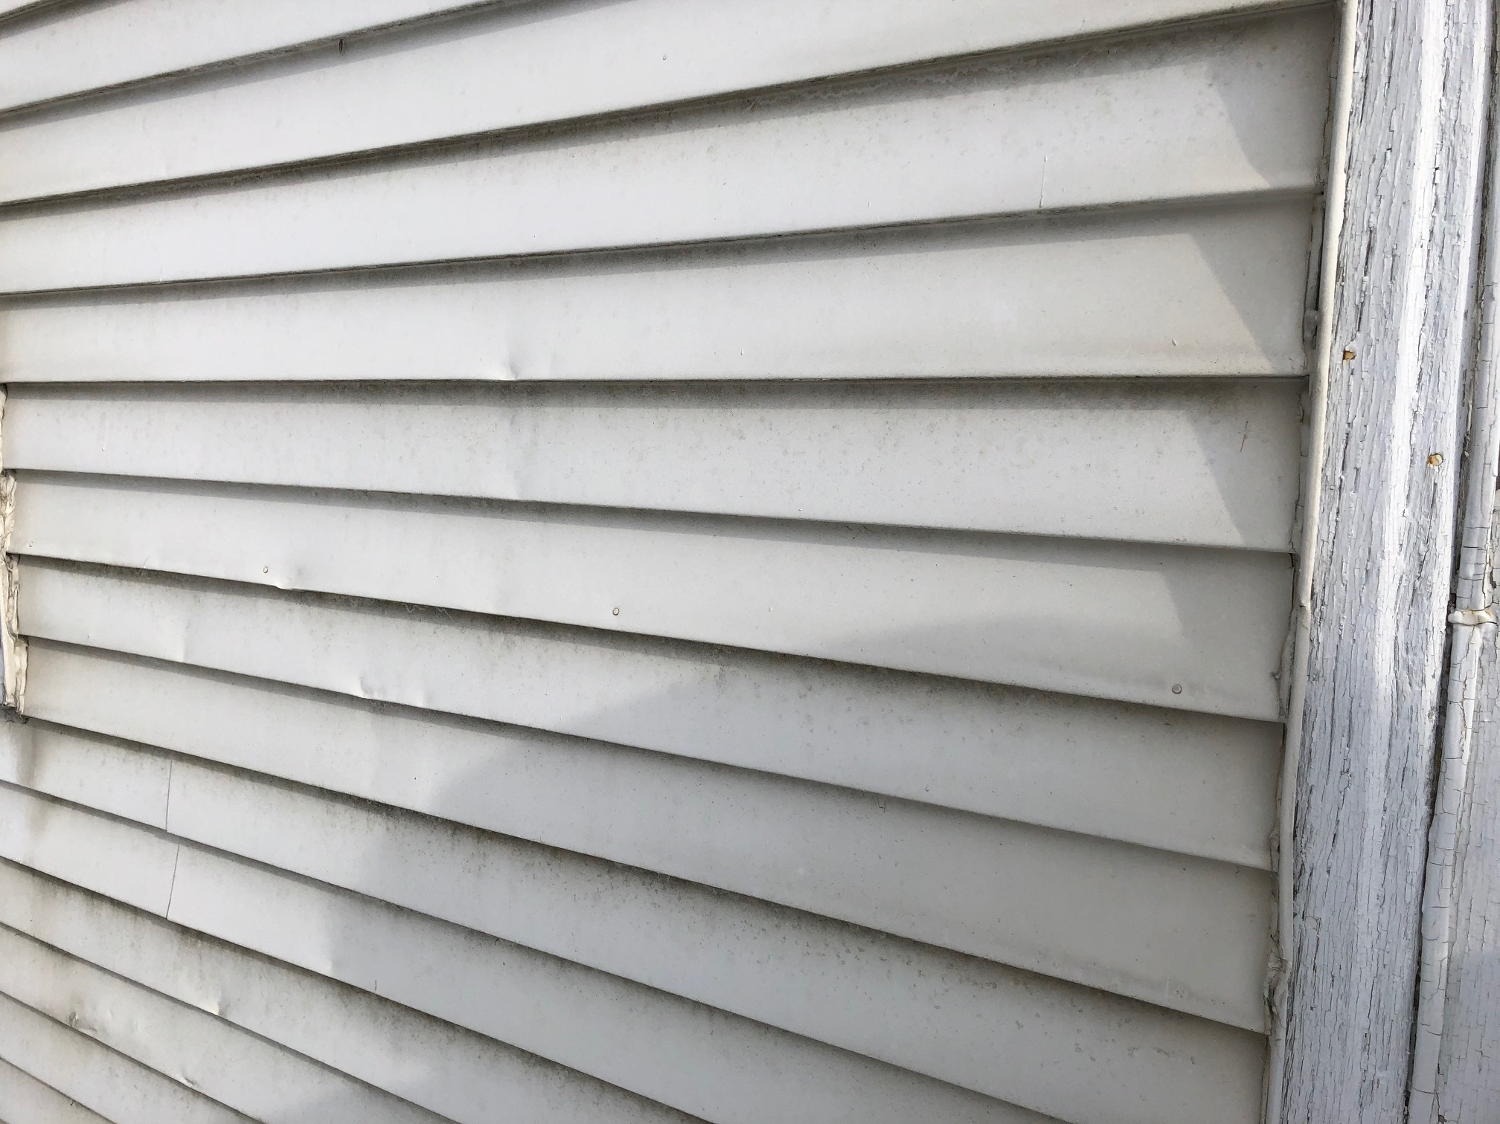
ALUMINUM

Slide 7
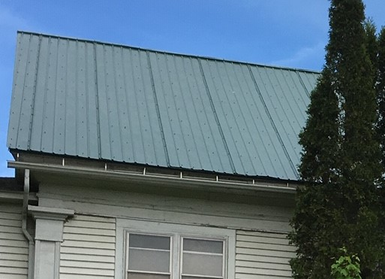
CORRUGATED METAL

Slide 8
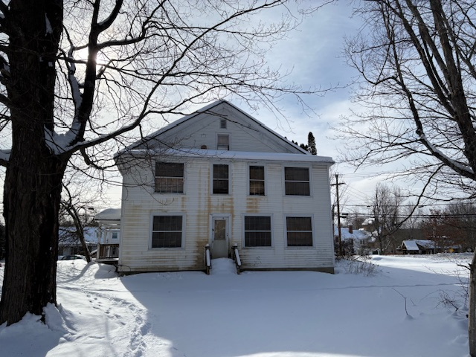
Challenges
All materials need to be replaced
No entrances are ADA compliant
Not structurally compliant
Not energy code compliant
New intersection

Slide 9
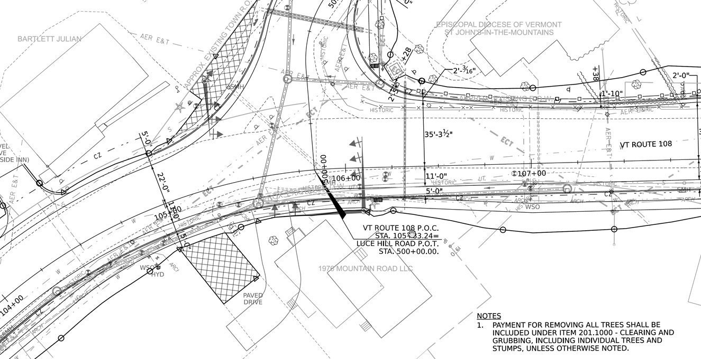
CHURCH
RIVERSIDE INN
EXISTING BUILDING
EXISTING DRIVEWAY

Slide 10
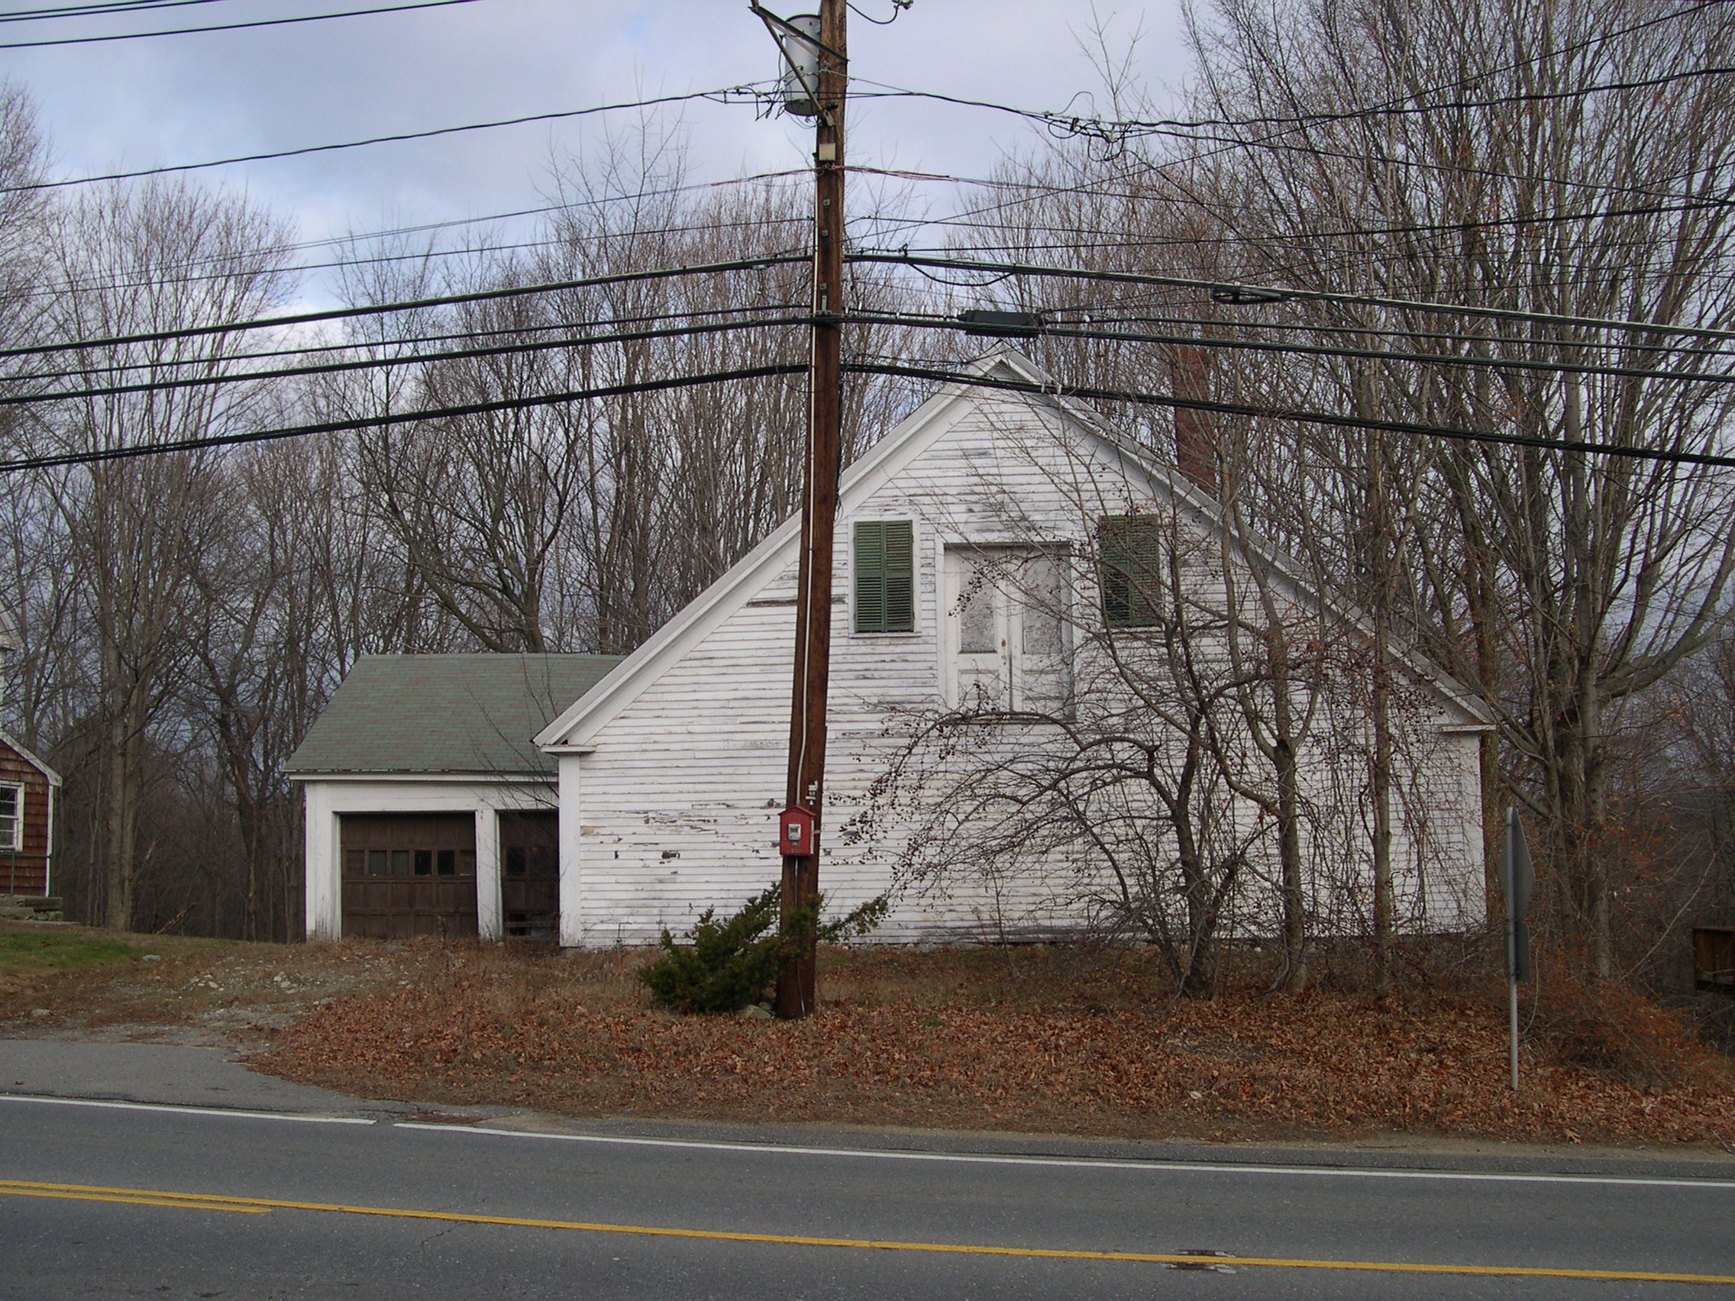
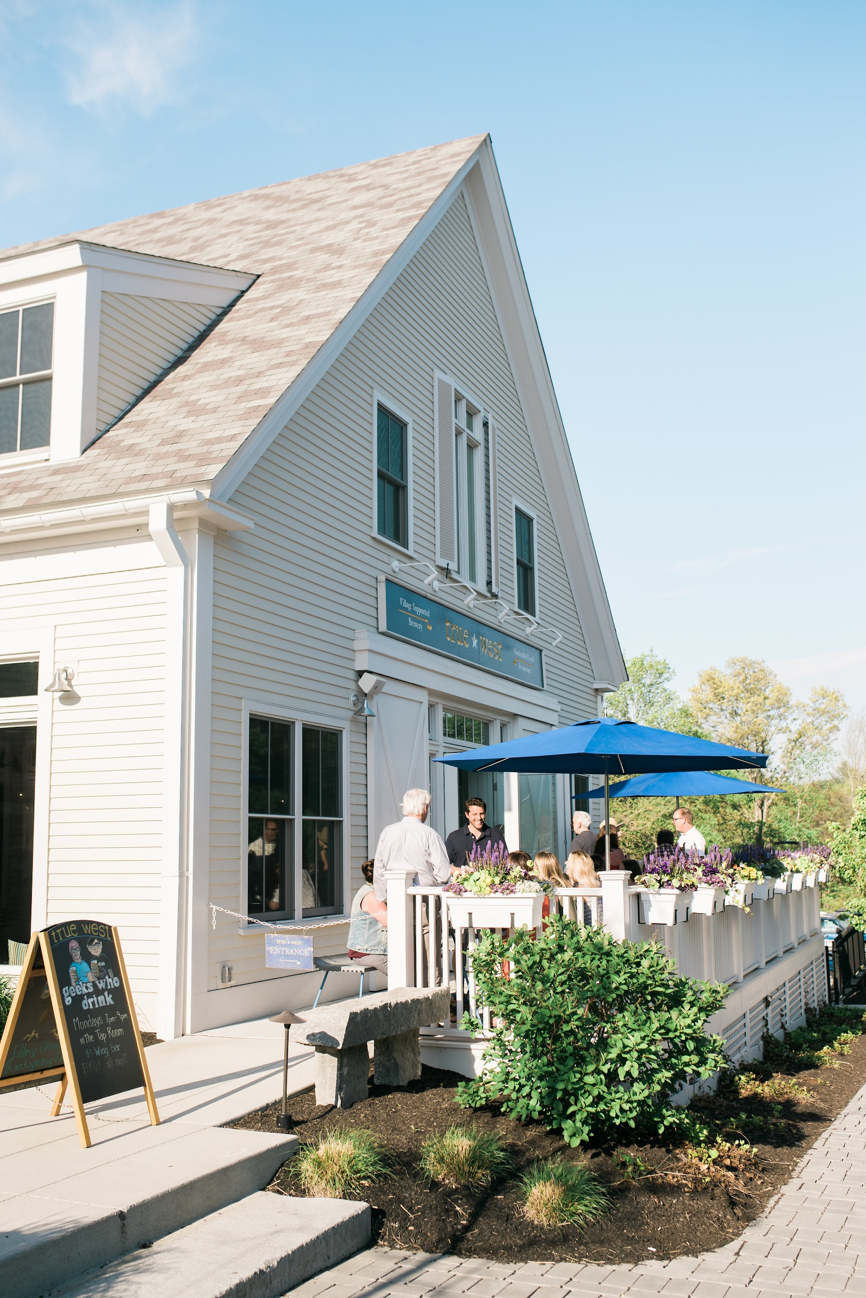
Similar Project: Mass Ave, Acton, MA
Part of Local Historic District in New England Village
Part of larger site / Master Plan
Poor material quality - nothing real to be saved
Structurally deficient
Not ADA compliant
Energy upgrades impractical
https://www.newhabitatpartners.com/

Slide 11
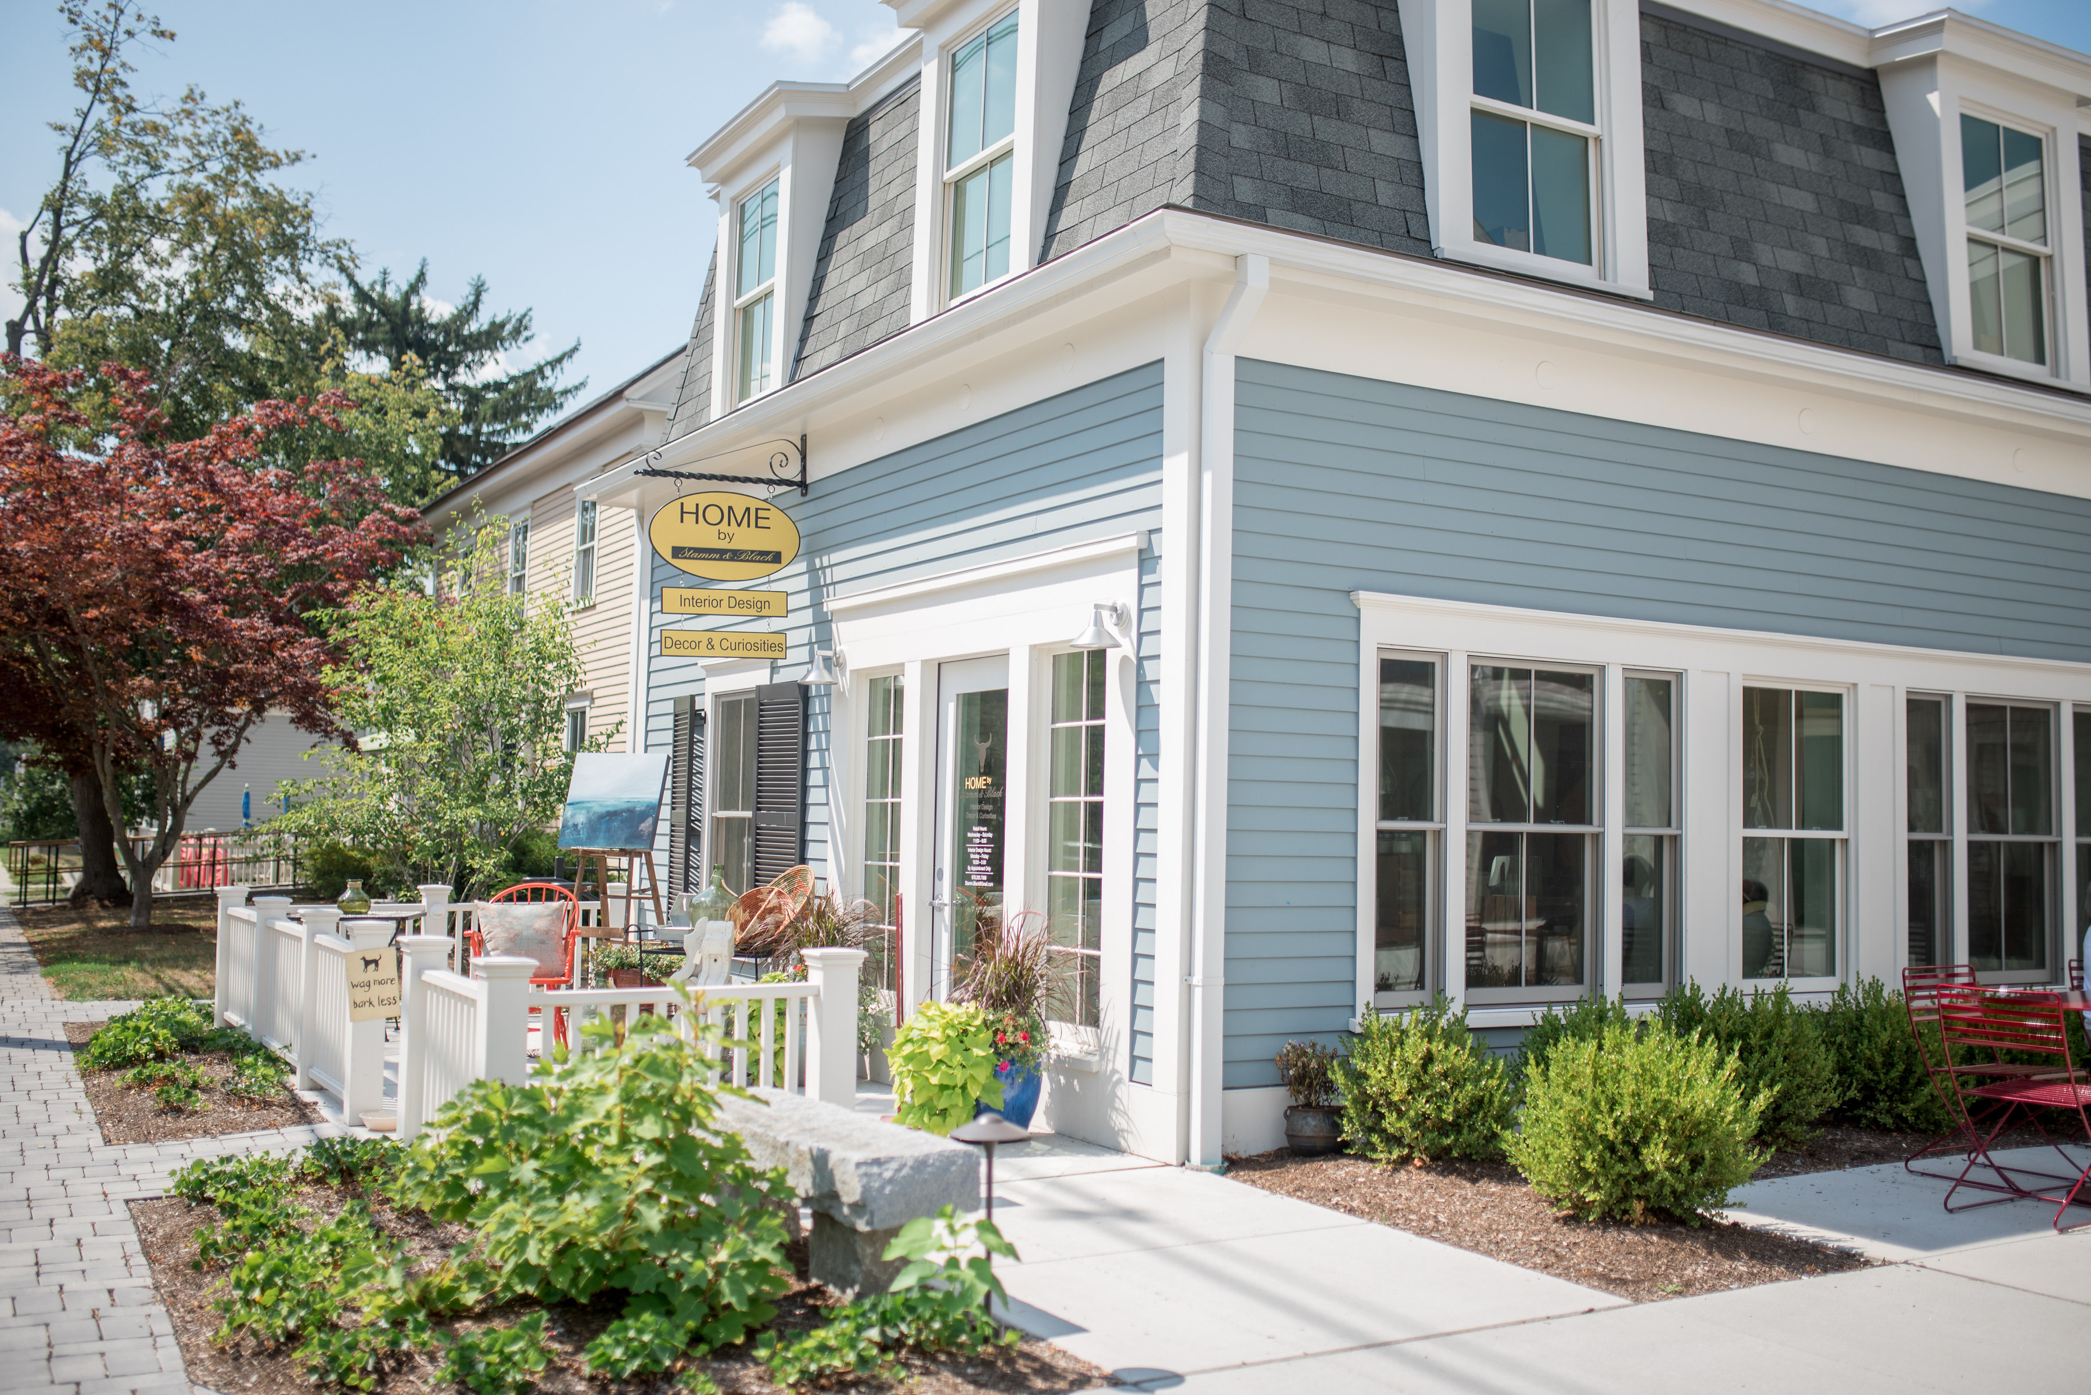
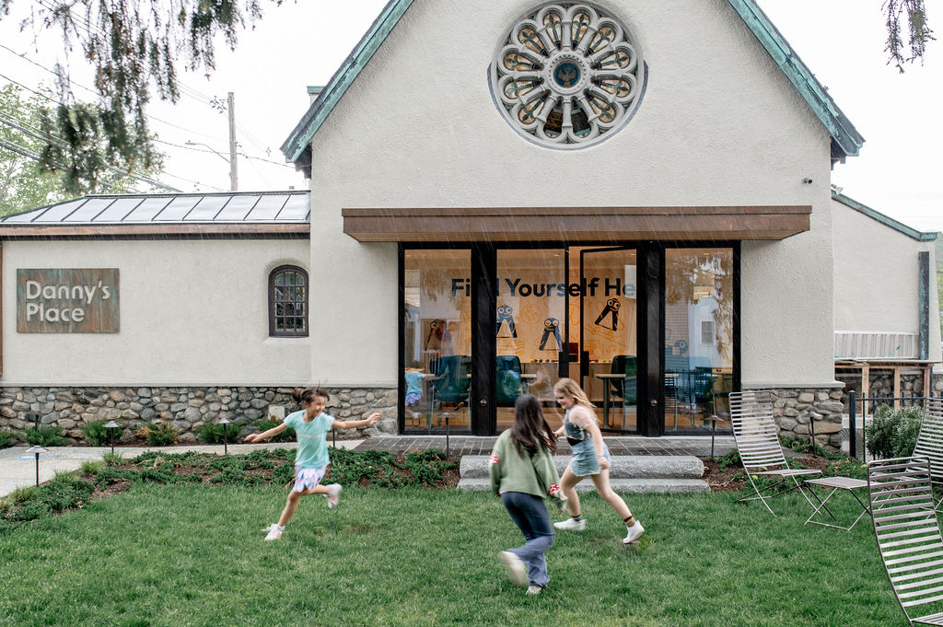
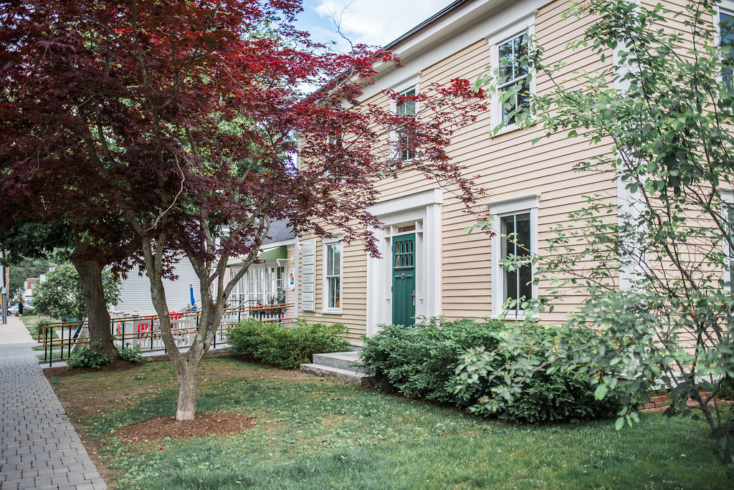
Other Historic District Projects: Mass Ave, Acton, MA
https://www.newhabitatpartners.com/

